Slide 1
Yearly GDP Growth
Of Major African Countries
By: Alpha Kaba

Slide 2
Where my Data Came from
African Economic Forum:
https://au.int/en/flagships/african-economic-forum
Includes key features that equate to countries ‘success’
Tells a story within itself
GDP is a universally accepted key indicator of economic success

Slide 3
What Am I addressing?
(Business Problem)

Slide 4


Financial Discrepancies
There are major differences in GDP growth all across Africa, especially regionally
I wanted to detail how severe those discrepancies were and why they exist

Slide 5
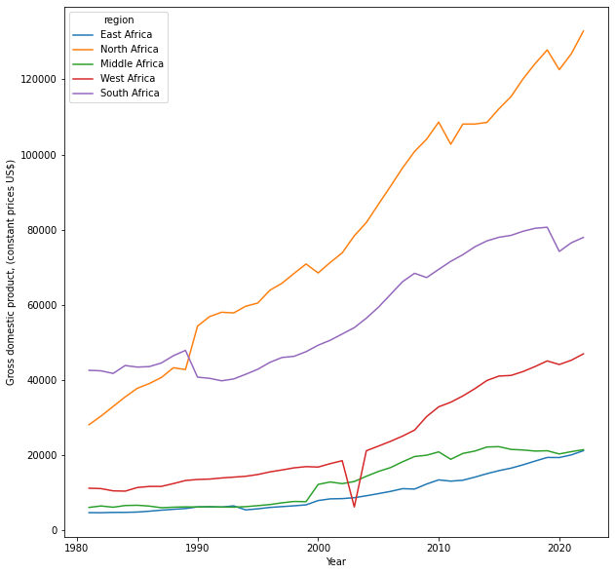
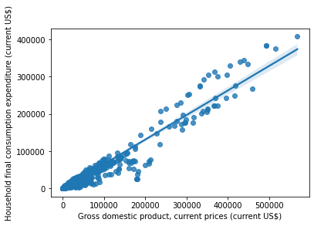
The writings on the walls
African GDP Growth Annually(Regional)
Positive Correlation between GDP and essentially ‘consumer spending’

Slide 6
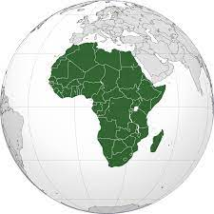
My Model
Decision Tree Regression Model
99% Accuracy
My target was GDP growth % annually
Low error model
Limitations:
Correlation does not always = Causation
Not the widest range of features

